Slide 1
Cost-Surface Analysis: An introduction
Kody Hedder

Slide 2
Cost-surface
What is the Cost-surface?
Digitized topography of a landscape which can be can be manipulated through the processes of spatial queries which can answer questions about past movements.
What is Cost-surface analysis?
Addresses the problems of movement within the landscape from point A to point B.
How does one model cost?
Either by distance or time taken to reach the destination from a starting point.
Notes:
Is an algorithm based off the geographical informations system (or GIS) software which is a computer based set of procedures for storing, manipulating, analysing, creating and displaying spatially referenced data. this type of spatial analysis has been around since the 60’s but it was only with the onset of microcomputer technology that made this process faster and widely available.

Slide 3
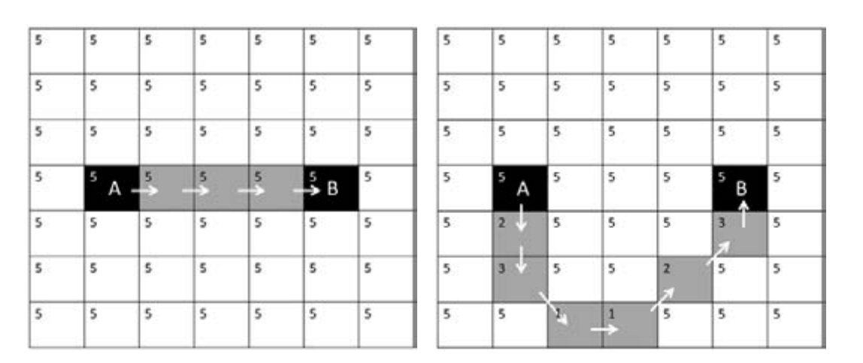
Movement across a landscape showing both uniform cost (left) and non-uniform cost (right). Surface-Evans, S., & White, D. A. (2012). An introduction to the least cost analysis of social landscapes. In, Least Cost Analysis of Social Landscapes : Archaeological Case Studies. Salt Lake City: University of Utah Press.
Shortest distance or least cost?
Landscapes are not always homogenous and vary in terms of vegetation cover, topography, slope, sight of the landscape and other social and cultural factors.
Notes:
there are two types of data, vector data and raster data. Vector data is shown as a line while raster data are shown as cells. (imagine Super Mario- likened to pixels) Now for spatial queries in looking at least cost paths, raster is the better option for taking on this query as you can assign values each of the cells in regards to impedance or cost.

Slide 4
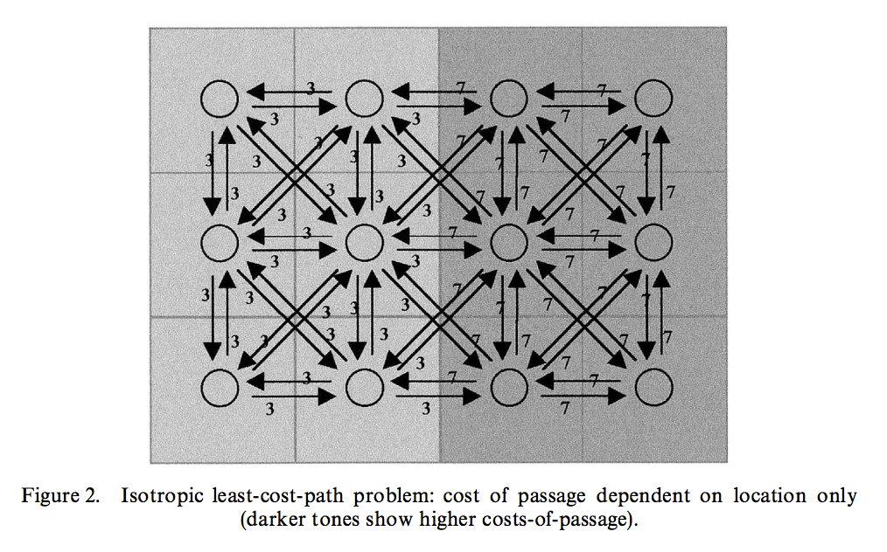
Collischonn, W., & Pilar, J. V. (2000). A direction dependent least-cost-path algorithm for roads and canals. International Journal of Geographical Information Science, 14(4), 397–406.
Direction costs vary
Based on slope - has the same value in all directions (independent of direction)
Valley compared to a plateau separated by a vertical surface
Notes:
spreading function that begins at the previously defined end-point of the path. When the procedure is initiated only the cell containing the end-point has a defined value of accumulated cost, and the spreading algorithm searches the eight neighbouring cells, stopping on the first that has no previously assigned accumulated cost value. From this cell, the algorithm begins another search of its eight neighbours to find those with defined values of accumulated cost. For each of them the cost-of passage of the cell is added, and the smallest is recorded as the accumulated cost of
the cell. This procedure is repeated until every cell has been assigned a cumulative cost value
From there a new surface is created on top of the cumulative cost value where the program will run an analysis from a designated point in which the user chooses to a point of interest. the output of this analysis is the shortest route from A to B.
Thats the computer side of things. What archaeologists are interested in is the outputs that are provided from these spatial queries.

Slide 5
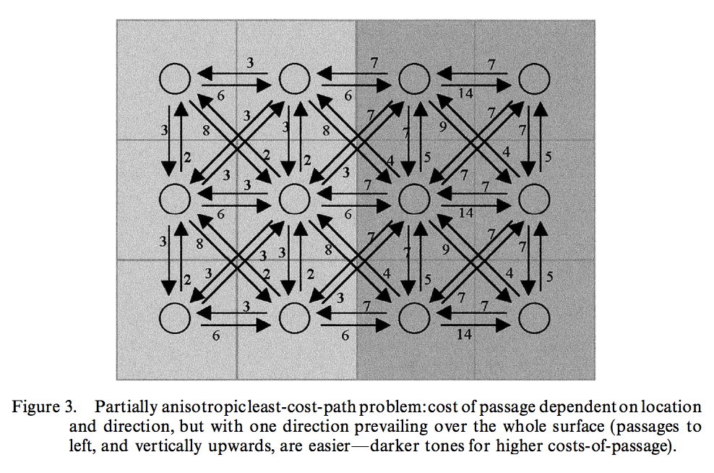
Collischonn, W., & Pilar, J. V. (2000). A direction dependent least-cost-path algorithm for roads and canals. International Journal of Geographical Information Science, 14(4), 397–406.
Direction costs vary
Partially anisotropic - operating from a particular direction. Cost will be greater from one direction than from the other. (cost dependent on constant direction)
non-homogenous landscape
Notes:
IF we take two locations that are at the same distance away from the source there is a high possibility that from one location it will be much more difficult to reach the source location due to the fact that landscapes are not always homogenous. Also adding to the fact, some areas will be socially dangerous or taboo due to the fact of some areas being mitigated as burial grounds therefore must be avoided.
So it comes down to this fact of do we expend less energy and take a longer route or expend more energy and take the shorter route? this is the dichotomy of which archaeologists face in whether to interpret time taken to reach the location (Distance) or cost (energy expenditure)

Slide 6
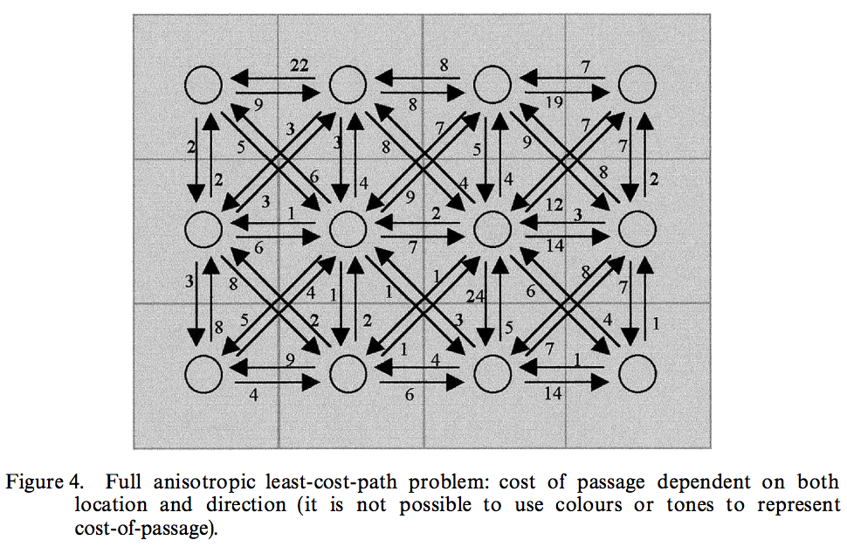
Collischonn, W., & Pilar, J. V. (2000). A direction dependent least-cost-path algorithm for roads and canals. International Journal of Geographical Information Science, 14(4), 397–406.
Direction costs may vary
Fully anisotropic - change in direction either increases or decreases cost. (dependent of direction)

Slide 7
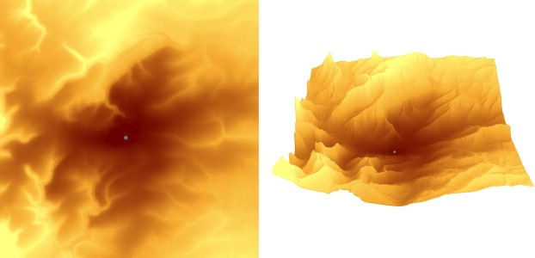
Fig. 1. Accumulated cost surface seen as raster image (left) and as a ‘2.5D’ topography (right). Valleys represent lower accumulations of costs (i.e. least-cost areas for movement). The destination is the grey dot located at the “steam of the funnel”.
Llobera, M., Fábrega-Álvarez, P., & Parcero-Oubiña, C. (2011). Order in movement: A GIS approach to accessibility. Journal of Archaeological Science, 38(4), 843–851.
What kind of anisotropic path is this showing?

Slide 8
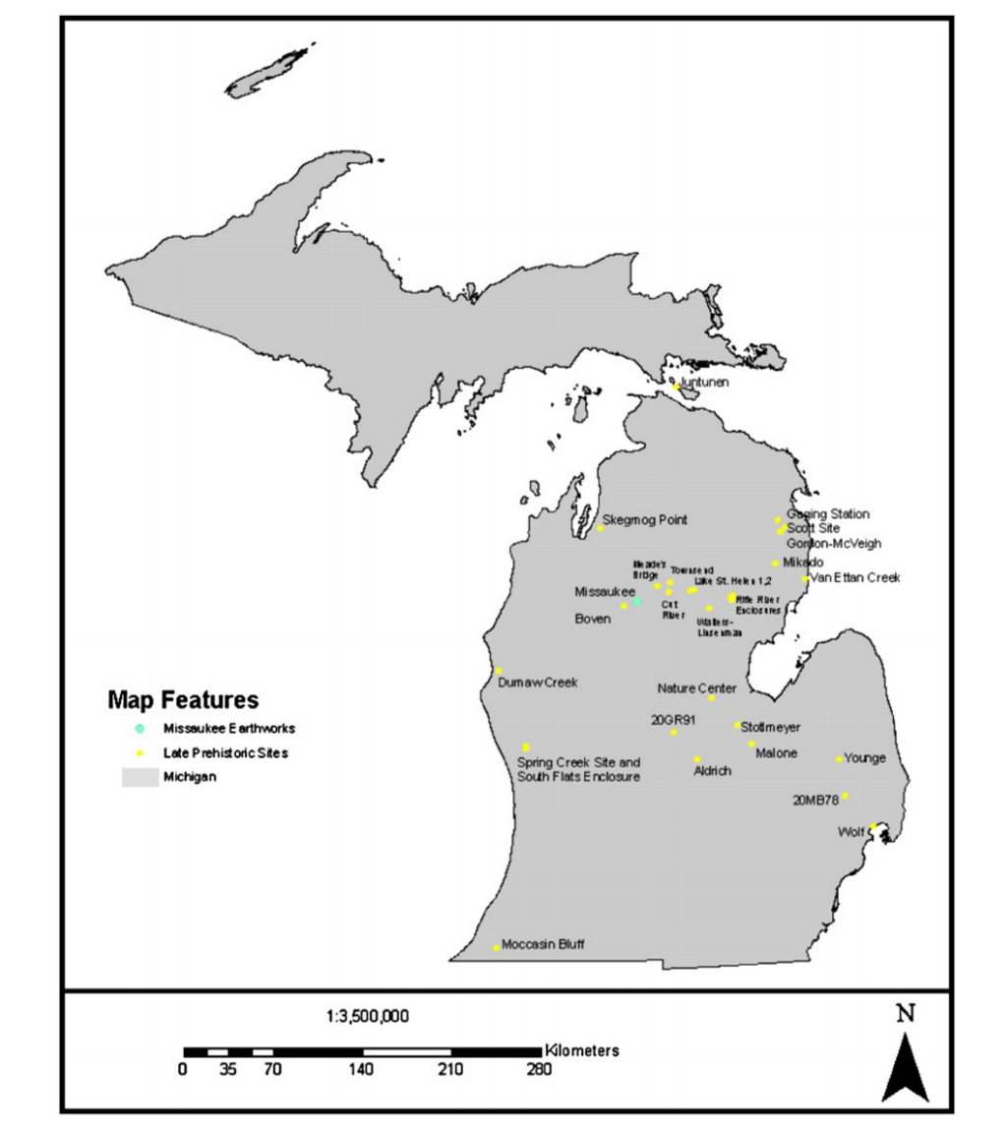
Case study
Howey, M. C. L. (2007). Using multi-criteria cost surface analysis to explore past regional landscapes: a case study of ritual activity and social interaction in Michigan, AD 1200–1600. Journal of Archaeological Science, 34(11), 1830-1846.

Slide 9
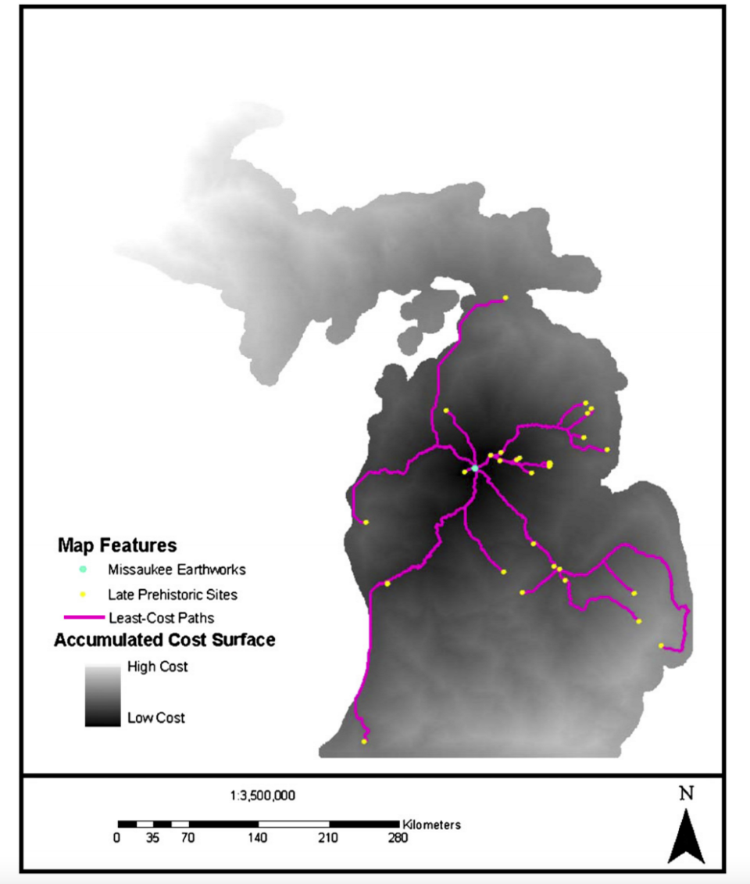
Used a raster DEM to look at the cost surfaces to work out a least cost path to different sites
Howey, M. C. L. (2007). Using multi-criteria cost surface analysis to explore past regional landscapes: a case study of ritual activity and social interaction in Michigan, AD 1200–1600. Journal of Archaeological Science, 34(11), 1830-1846.

Slide 10
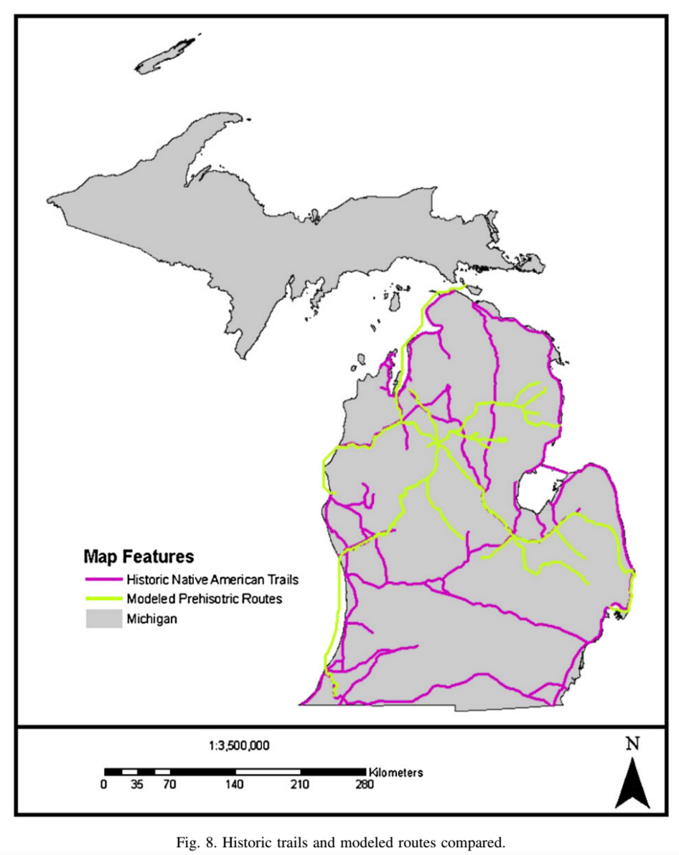
Modelled routes do not match the historical routes taken
Howey, M. C. L. (2007). Using multi-criteria cost surface analysis to explore past regional landscapes: a case study of ritual activity and social interaction in Michigan, AD 1200–1600. Journal of Archaeological Science, 34(11), 1830-1846.

Slide 11
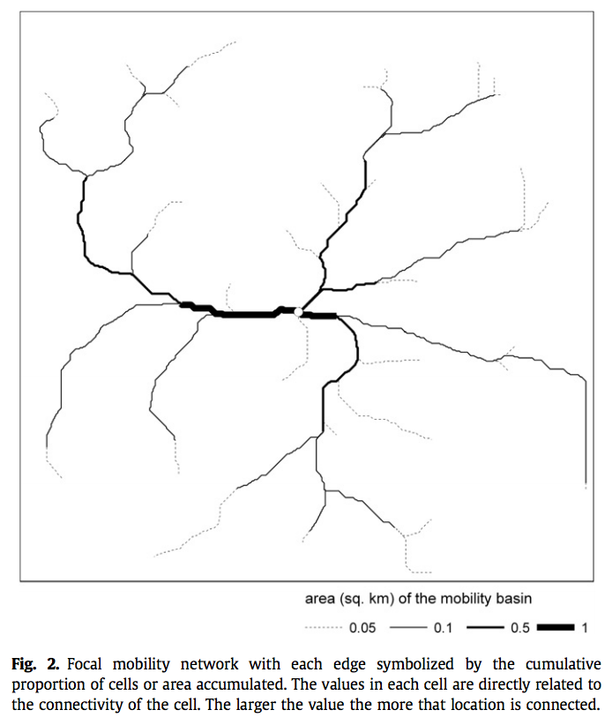
Case study
Focal mobility network
Llobera, M., Fábrega-Álvarez, P., & Parcero-Oubiña, C. (2011). Order in movement: A GIS approach to accessibility. Journal of Archaeological Science, 38(4), 843–851.

Slide 12
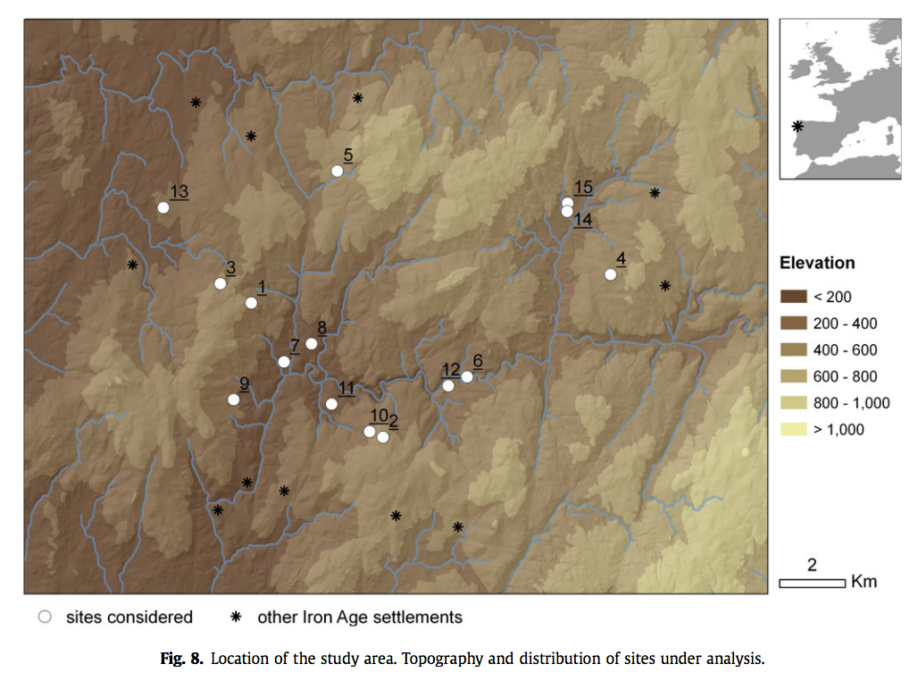
Llobera, M., Fábrega-Álvarez, P., & Parcero-Oubiña, C. (2011). Order in movement: A GIS approach to accessibility. Journal of Archaeological Science, 38(4), 843–851.

Slide 13
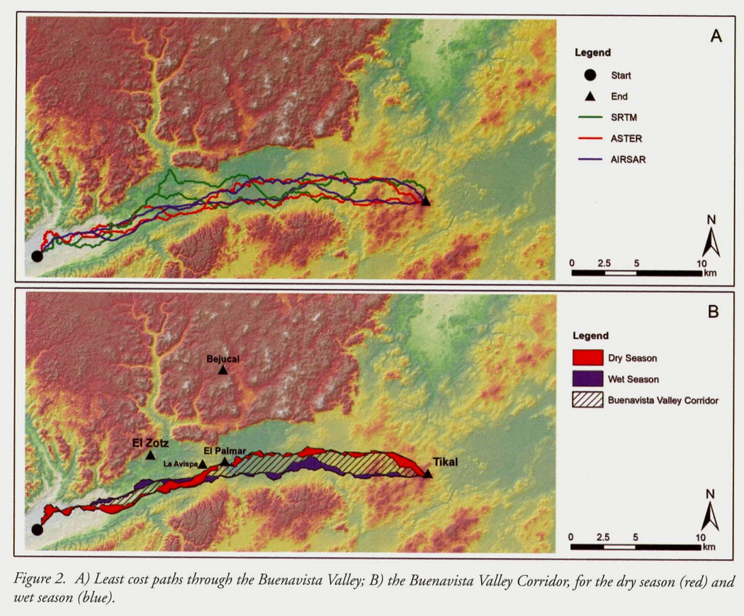
Doyle, J. A., Garrison, T. G., & Houston, S. D. (2012). Watchful realms: Integrating GIS analysis and political history in the southern maya lowlands. Antiquity, 86(333), 792–807

Slide 14
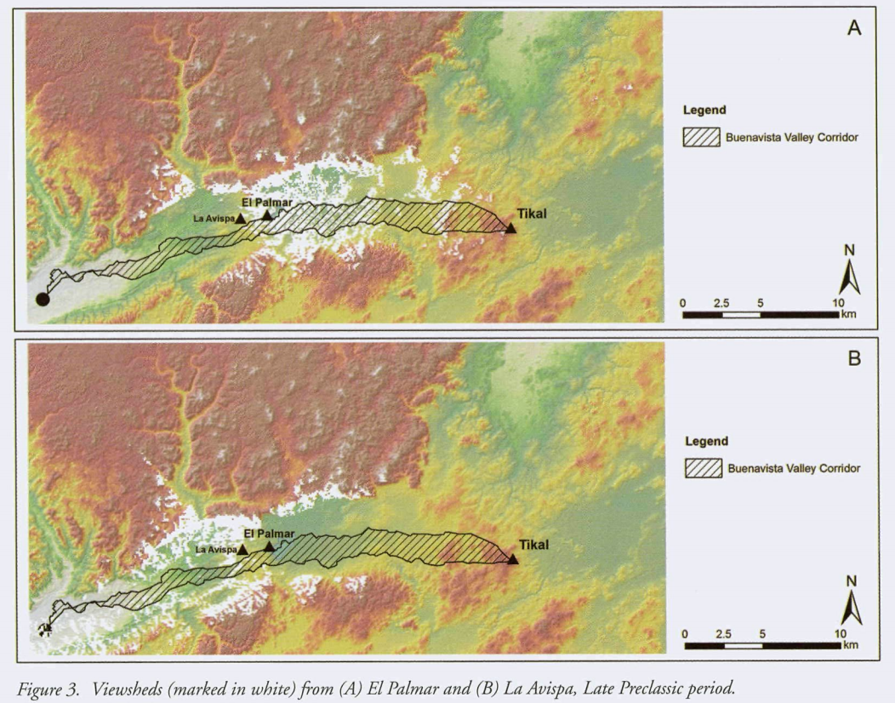
Doyle, J. A., Garrison, T. G., & Houston, S. D. (2012). Watchful realms: Integrating GIS analysis and political history in the southern maya lowlands. Antiquity, 86(333), 792–807

Slide 15
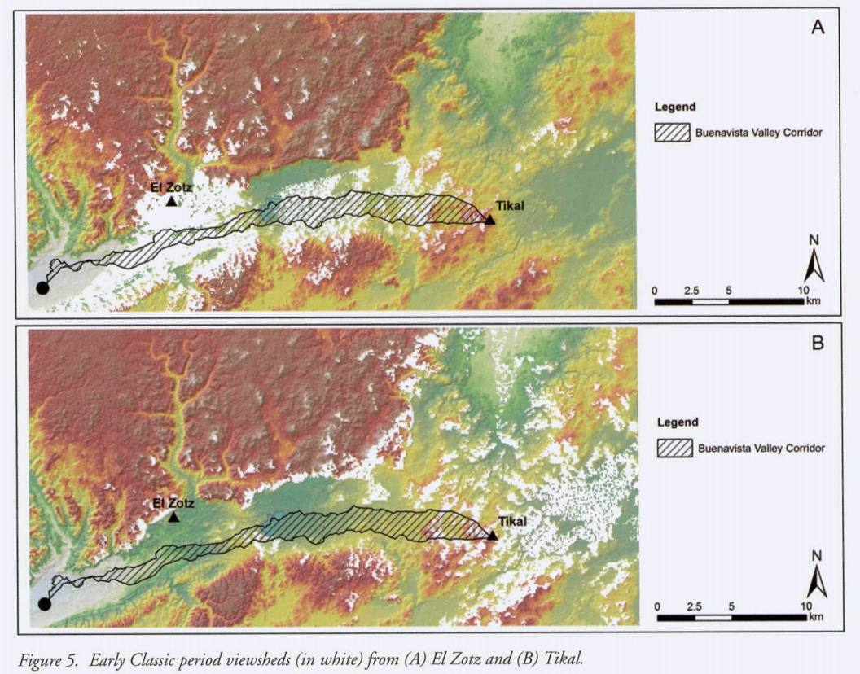
Doyle, J. A., Garrison, T. G., & Houston, S. D. (2012). Watchful realms: Integrating GIS analysis and political history in the southern maya lowlands. Antiquity, 86(333), 792–807

Slide 16
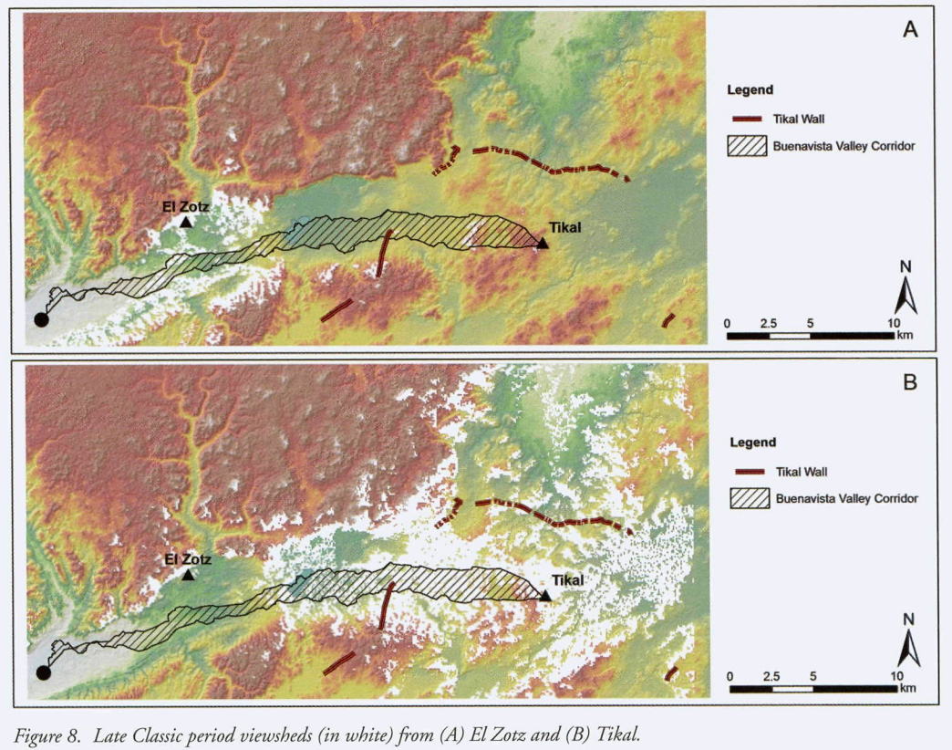
Doyle, J. A., Garrison, T. G., & Houston, S. D. (2012). Watchful realms: Integrating GIS analysis and political history in the southern maya lowlands. Antiquity, 86(333), 792–807

Slide 17
What is the cost surface?
Is an algorithm based off the geographical informations system (or GIS) software which is a computer based set of procedures for storing, manipulating, analysing, creating and displaying spatially referenced data. this type of spatial analysis has been around since the 60’s but it was only with the onset of microcomputer technology that made this process faster and widely available.
How is it shown Spatially?
Through a DEM- digital elevation model is the basis of where GIS comes from in which the topographical map is digitised making spatial queries easier to manipulate.
How does it work?
there are two types of data, vector data and raster data. Vector data is shown as a line while raster data are shown as cells. (imagine Super Mario- likened to pixels) Now for spatial queries in looking at least cost paths, raster is the better option for taking on this query as you can assign values each of the cells in regards to impedance or cost.
Plugging it into the software- how it is calculated
spreading function that begins at the previously defined end-point of the path. When the procedure is initiated only the cell containing the end-point has a defined value of accumulated cost, and the spreading algorithm searches the eight neighbouring cells, stopping on the first that has no previously assigned accumulated cost value. From this cell, the algorithm begins another search of its eight neighbours to find those with defined values of accumulated cost. For each of them the cost-of passage of the cell is added, and the smallest is recorded as the accumulated cost of
the cell. This procedure is repeated until every cell has been assigned a cumulative cost value
From there a new surface is created on top of the cumulative cost value where the program will run an analysis from a designated point in which the user chooses to a point of interest. the output of this analysis is the shortest route from A to B.
Thats the computer side of things. What archaeologists are interested in is the outputs that are provided from these spatial queries.

Slide 18
Differing Landscapes- Not always homogenous
IF we take two locations that are at the same distance away from the source there is a high possibility that from one location it will be much more difficult to reach the source location due to the fact that landscapes are not always homogenous. Also adding to the fact, some areas will be socially dangerous or taboo due to the fact of some areas being mitigated as burial grounds therefore must be avoided.
So it comes down to this fact of do we expend less energy and take a longer route or expend more energy and take the shorter route? this is the dichotomy of which archaeologists face in whether to interpret time taken to reach the location (Distance) or cost (energy expenditure)
A Critique: However, archaeologists are under the assumption that any person within a given regional context will take the path that minimises energy expenditure and transport costs however we must be weary that in our contemporary framework we have become naturally lazy and in turn, under this assumption, have assumed that prehistorical people are also the same.
travelling through the landscape one can encounter a range of different topographic features that will either impede movement such as a mountain range or facilitate movement such as a river.
However, how topographic elements are interpreted comes down to the view of the user and a good example of this is the river situation as a river can be both a facilitator of movement or create impedance.
cost surface analysis involves the creation of a digital raster of the landscape in which a pixel is assigned a cost in the form of a number designated by the user to determine impedance.
Now developing an algorithm for a cost surface model is dependent on the user as one could show one factor that determines movement or have multiple factors that will provide the possibility of a much more real senario of how past peoples navigated the landscape.
Case study in Michigan.
The shift of maize being cultivated in a limited manner to being used as an economic commodity saw the development of more intensive interactions between local groups. With interactions came a growth in boundaries and cultural identity and see a shift in ceramic styles around 1000-1200 AD.
The Missaukee Earthworks were important cultural centre in the late prehistoric in which communities gathered.
Criteria were selected based on topographical attributes that were possibly significant factors in how people moved which were slope, vegetation cover and waterways.

